Slide 1


30 Years of HSIs:
Improving Access to Quality for 30%
Webinar
April 16th, 2pm ET
www.EdExcelencia.org @EdExcelencia #LatinoStudentSuccess

Slide 2
Today’s Agenda
Welcome and Introduction
Overview of Excelencia’s latest analysis on HSIs
Panel discussion with institutional leaders
www.EdExcelencia.org @EdExcelencia #LatinoStudentSuccess

Slide 3


This year marks 30 years of federal funding for HSIs.
1992: HSIs first included in legislation in the Higher Education Act.
1995: HSIs received dedicated federal funding to build capacity, improve academic quality, and expand access for Latino and
other low-income students through the Developing Hispanic-Serving Institutions Program (Title V).
2025: Over 30 years, funding for HSIs in Title V, Part A has increased but the number of HSIs has also grown.
While most HSIs have applied for Title V funds at least once,
less than one in three have been awarded this funding.
www.EdExcelencia.org @EdExcelencia #LatinoStudentSuccess

Slide 4
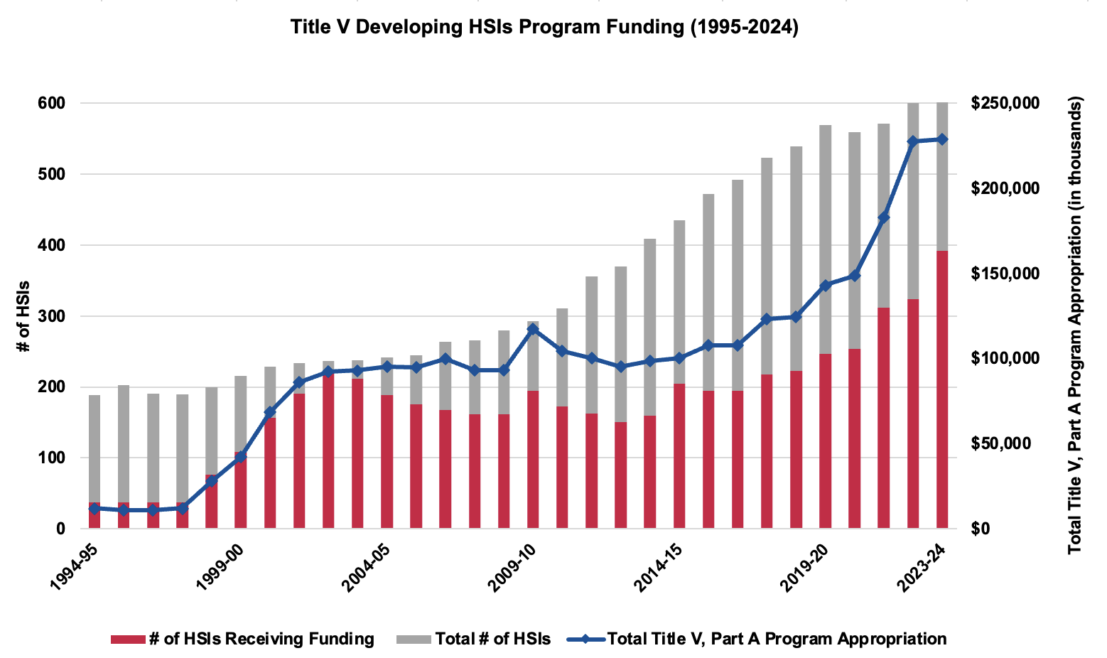
Over 30 years, funding for HSIs has increased; the number of HSIs has grown significantly as well.
Source: Excelencia in Education analysis using U.S. Department of Education, NCES, IPEDS, 1994-2023 Fall Enrollment and Institutional Characteristics Surveys; and, U.S. Department of Education, Developing Hispanic-Serving Institutions Program - Title V Funding Status, https://www2.ed.gov/programs/idueshsi/funding.html
www.EdExcelencia.org @EdExcelencia #LatinoStudentSuccess

Slide 5
Over 1,000 institutions are now HSIs or on their way to becoming an HSI. Over 250 offer graduate programs.
602
HSIs
418
eHSIs
+
=
1,020
institutions
257
gHSIs
Subset of HSIs
Source: Excelencia in Education analysis using U.S. Department of Education, NCES, IPEDS, 2023 Fall Enrollment, Institutional Characteristics, and Completions Surveys.
www.EdExcelencia.org @EdExcelencia #LatinoStudentSuccess

Slide 6
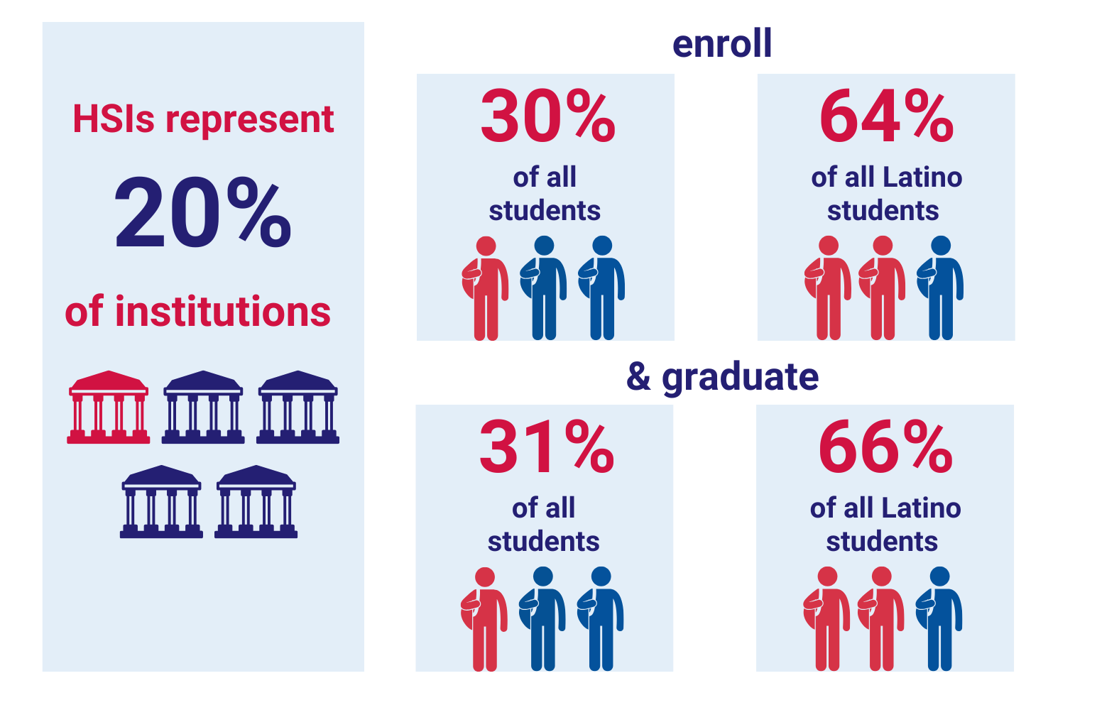
HSIs enroll and graduate one-third of all students and two-thirds of all Latino undergraduates in the nation.
Source: Excelencia in Education analysis using U.S. Department of Education, NCES, IPEDS, 2023 Fall Enrollment, Institutional Characteristics, and Completions Surveys.
www.EdExcelencia.org @EdExcelencia #LatinoStudentSuccess

Slide 7
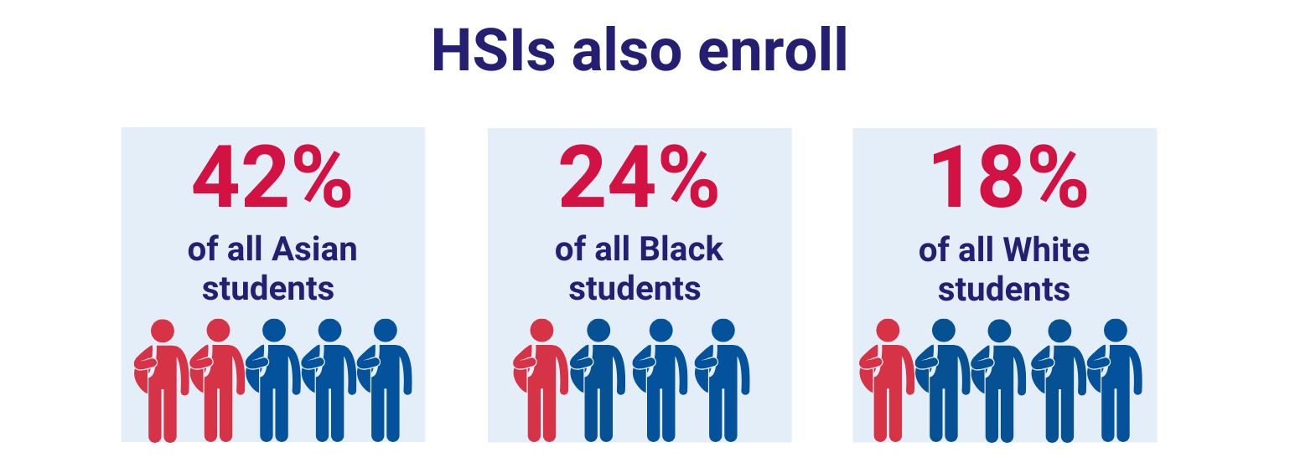
HSIs enroll a high concentration of students from various backgrounds.
Source: Excelencia in Education analysis using U.S. Department of Education, NCES, IPEDS, 2023 Fall Enrollment, Institutional Characteristics, and Completions Surveys.
www.EdExcelencia.org @EdExcelencia #LatinoStudentSuccess

Slide 8
Learn more about Excelencia’s analysis on HSIs and more
EdExcelencia.org/research-policy/hispanic-serving-institutions-hsis
www.EdExcelencia.org @EdExcelencia #LatinoStudentSuccess

